Slide 1
Control Logic Synthesis for Manufacturing System using Rule-based algorithm
MLP Group6
2023321221 Seokjoo Park
2024311384 Gyuman Park
2024311275 Hyunjun Choi
2023314048 Sungmin Lee

Slide 2
Contents
Introduction
Rule based algorithm
Simulation
Results
Future work

Slide 3
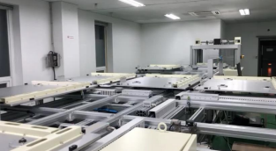
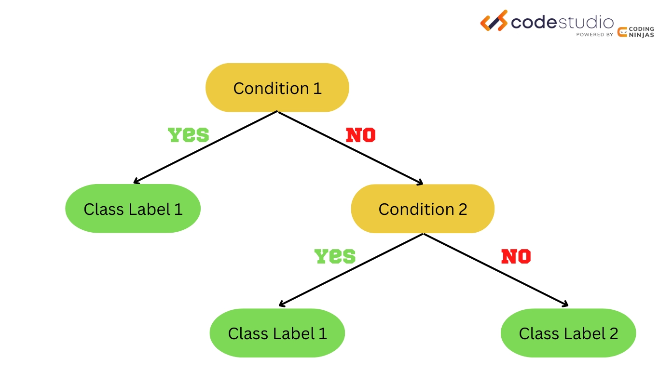
Introduction
Control logic synthesis for manufacturing system
Rule-based algorithm
Automatic production in manufacturing system
Developing a software for the manufacturing system
→ Require a huge labor cost
Operates on a predefined set of rules or conditions to make decisions or perform task
Advantages of Rule based algorithm
Simplicity & Maintainability
Predictability & Stability
Fig1. Manufacturing System
Fig2. Schematic of Rule based algorithm

Slide 4
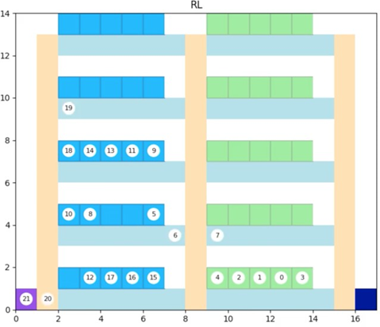
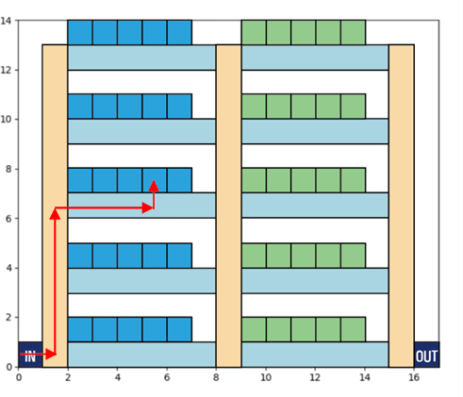
Introduction
Inspection process LCD production line
Goal of project
→ Aim to reduce the tact time of the inspection process.
LCD pallets inspection process (figure 3&4)
Pallets enter test section and move to assigned testers
Pallet enters via purple entrance, goes to corresponding tester level via yellow corridor
Pallet reaches tester, undergoes first inspection in blue area
After first inspection, pallet exits tester, moves to second tester via green corridors
Once second inspection is done, pallet exits through navy exit
Conditions
Test can only inspect one pallet at one time
Testers are physically in the same height
Fig3. Pallets assigned to testers
Fig4. Movement path of pallets

Slide 5
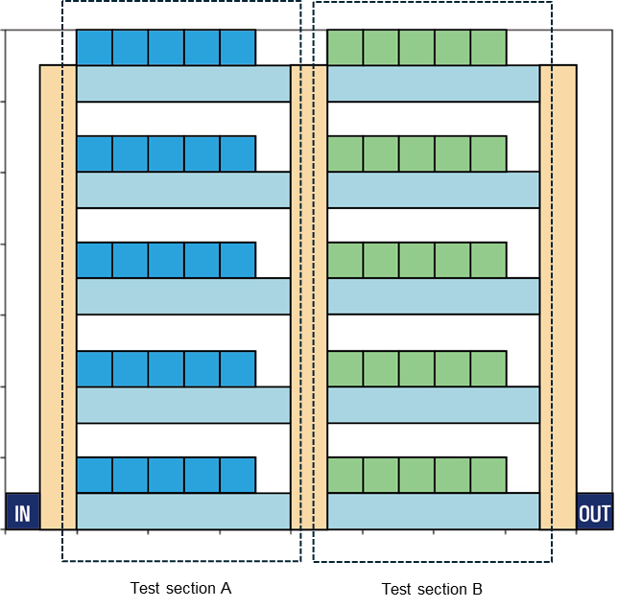
Rule based algorithm
Scheduling by rule based algorithm
Priority
No collision between pallets
Maintain the flow (Pallets continuously enter and exit the whole section)
Maximized production over time
Assumption
Pallets are scheduled by the order of pallet number
Testers inspect pallets that were assigned to them first.
Two-way movements are only possible in the middle corridor.
Rules
Among the available testers on the same row, a pallet is assigned on the inside tester.
Among the available schedules (for tester A, tester B), a pallet chooses the schedule with the shortest route.
Fig5. Test section of system

Slide 6
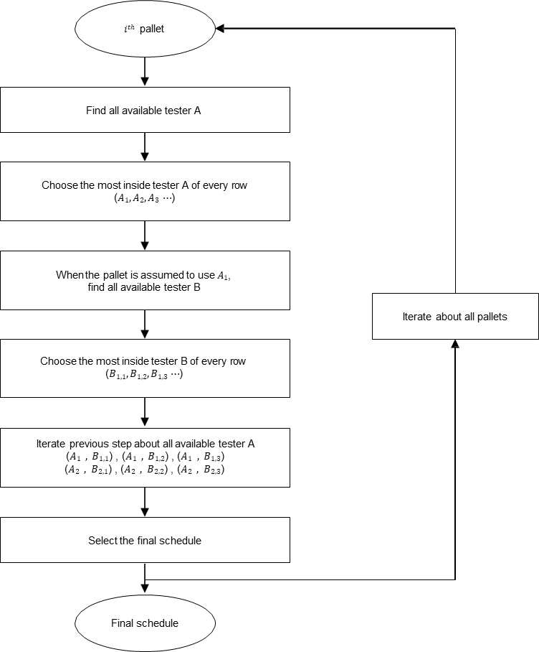
Rule based algorithm - Scheduling
Scheduling flow chart & Scheduling flag
Scheduling
Scheduling Flag
FLAG | Description | Advantages
FCFS (First-Come, First-Served) | Processes in order of arrival | Simple, fair in terms of arrival
MIN | Selects least occupied resource | Balances load, avoids overuse
Priority scheduling | Based on priority levels | Ensures important tasks handled first
Round robin | Equal CPU time slices | Fair time distribution, prevents monopolization
SJN (Shortest Job Next) | Shortest job processed first | Reduces average waiting time

Slide 7
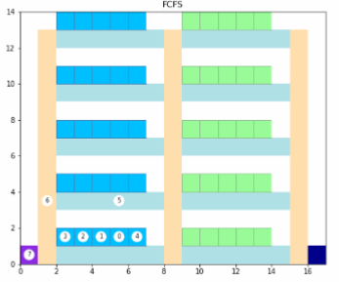
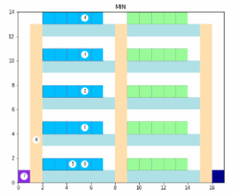
Rule based algorithm - Scheduling
FCFS vs MIN
FCFS Scheduling
MIN Scheduling
Pallet selects the first available tester floor
→ Order-based & Simple implementation
Pallet selects the floor with the least occupied testers
→ Minimum occupancy & Load balancing

Slide 8
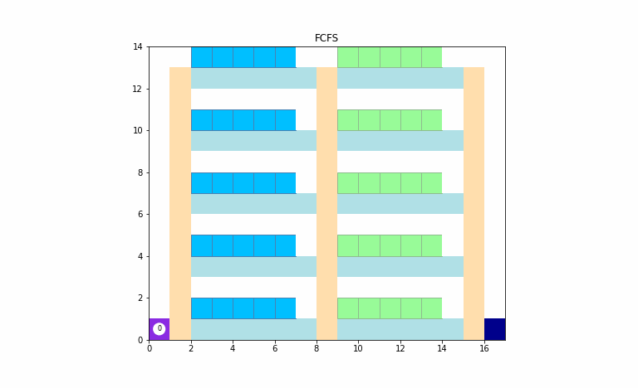

Simulation
Simulation of FCFS & MIN Scheduling
FCFS Scheduling
MIN Scheduling

Slide 9
Results
Sim-time(timesteps) of FCFS & MIN Scheduling
Sim-times: 1,135 steps
Sim-times: 1,526 steps
Optimized Rule-based algorithm for LCD Inspection
→ FCFS Scheduling

Slide 10
Future work
LCD inspection with DRL (Deep-Reinforcement Learning)
FCFS scheduling algorithm optimization → Reduce sim-time
Algorithm implementation using DRL → Simulation & Comparison with Rule-based algorithm (FCFS)

Slide 11
Thank you for listening Q&A

